Slide 1

LET US C
BY YASHAVANT KANETKAR
CH 8 Q[B]
CH 8 Q[D]
CH 8 Q[A]
CH 8 Q[C]
CHAPTER 8 SOLUTIONS
FUNCTIONS

Slide 2
CHAPTER 8 SOLUTIONS
FUNCTIONS
Q[A] What will be the output of the following programs:
CH 8 Q[A]
(a)
#include <stdio.h>
int main()
{
printf("Learn C\n");
display();
return 0;
}
void display()
{
printf("Followed by C++, C# and Java!\n");
main():
}
(b)
CH 8 Q[D]
CH 8 Q[C]
CH 8 Q[B]
(c)
(d)
DEAR CODING
BOOK: LET US C
BY YASHAVANT KANETKAR

Slide 3
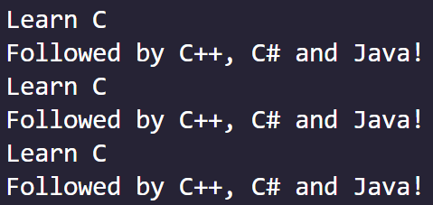
CHAPTER 8 SOLUTIONS
FUNCTIONS
(a)
👩‍💻 Output:
#include <stdio.h>
void display();
int main()
{
printf("Learn C\n");
display();
return 0;
}
void display()
{
printf("Followed by C++, C# and Java!\n");
main();
}
CH 8 Q[A](a)
DEAR CODING
✍️ Both the messages will get printed indefinitely.
BOOK: LET US C
BY YASHAVANT KANETKAR

Slide 4

CHAPTER 8 SOLUTIONS
FUNCTIONS
(b)
#include <stdio.h>
int check (int);
int main()
{
int i = 45, c;
c = check(i);
printf("%d\n", c);
return 0;
}
int check (int ch)
{
if (ch >= 45)
return (100);
else
return (10*10);
}
👩‍💻 Output:
CH 8 Q[A](b)
DEAR CODING
BOOK: LET US C
BY YASHAVANT KANETKAR

Slide 5

CHAPTER 8 SOLUTIONS
FUNCTIONS
(c)
#include <stdio.h>
float circle(int);
int main()
{
float area;
int radius = 1;
area = circle(radius);
printf("%f\n", area);
return 0;
}
float circle(int r)
{
float a;
a = 3.14*r*r;
return (a);
}
CH 8 Q[A]cb)
👩‍💻 Output:
DEAR CODING
BOOK: LET US C
BY YASHAVANT KANETKAR

Slide 6
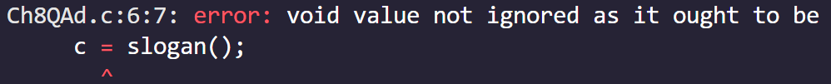
CHAPTER 8 SOLUTIONS
FUNCTIONS
(d)
#include <stdio.h>
int main()
{
void slogan();
int c = 5;
c = slogan();
printf("%d\n",c);
return 0;
}
void slogan()
{
printf("Only He men use C!\n");
}
✍️ Function prototype declaration can also be done inside another function. The problem is slogan() is assigned to c, but slogan() function does not return anything. Its return type is void.
CH 8 Q[A](d)
DEAR CODING
BOOK: LET US C
BY YASHAVANT KANETKAR

Slide 7


CHAPTER 8 SOLUTIONS
FUNCTIONS
(d)
#include <stdio.h>
int main()
{
void slogan();
int c = 5;
slogan();
printf("%d\n",c);
return 0;
}
void slogan()
{
printf("Only He men use C!\n");
}
CH 8 Q[A](d)
DEAR CODING
BOOK: LET US C
BY YASHAVANT KANETKAR

Slide 8
CHAPTER 8 SOLUTIONS
FUNCTIONS
Q[A] What will be the output of the following programs:
CH 8 Q[A]
(a)
(b)
#include <stdio.h>
int main()
{
printf("Learn C\n");
display();
return 0;
}
void display()
{
printf("Followed by C++, C# and Java!\n");
main():
}
(c)
CH 8 Q[D]
CH 8 Q[C]
CH 8 Q[B]
(d)
(e)
DEAR CODING
(f)
BOOK: LET US C
BY YASHAVANT KANETKAR

Slide 9
CHAPTER 8 SOLUTIONS
FUNCTIONS
Q[B] Point out the errors, if any, the following programs:
CH 8 Q[B]
(a)
#include <stdio.h>
int addmult (int, int)
int main()
{
int i = 3, j = 4, k, l;
k = addmult(i, j);
l = addmult(i, j);
printf("%d %d\n", k, l);
return 0;
}
int addmult (int ii, int jj)
{
int kk, ll;
kk = ii + jj;
ll = ii * jj;
return(kk, ll);
}
(b)
(c)
CH 8 Q[D]
CH 8 Q[C]
CH 8 Q[B]
(d)
(e)
DEAR CODING
(f)
BOOK: LET US C
BY YASHAVANT KANETKAR

Slide 10
CHAPTER 8 SOLUTIONS
FUNCTIONS
(a)
#include <stdio.h>
int addmult (int, int)
int main()
{
int i = 3, j = 4, k, l;
k = addmult(i, j);
l = addmult(i, j);
printf("%d %d\n", k, l);
return 0;
}
int addmult (int ii, int jj)
{
int kk, ll;
kk = ii + jj;
ll = ii * jj;
return(kk, ll);
}
❌
ERROR!
CH 8 Q[B](a)
✍️ ; is required at the end of function prototype declaration.
DEAR CODING
BOOK: LET US C
BY YASHAVANT KANETKAR

Slide 11
CHAPTER 8 SOLUTIONS
FUNCTIONS
(a)
#include <stdio.h>
int addmult (int, int);
int main()
{
int i = 3, j = 4, k, l;
k = addmult(i, j);
l = addmult(i, j);
printf("%d %d\n", k, l);
return 0;
}
int addmult (int ii, int jj)
{
int kk, ll;
kk = ii + jj;
ll = ii * jj;
return(kk, ll);
}
✍️ When the addmult function prototype declaration has ; at the end Then the output is 12 12
✍️ Since a function can return only one value, and the order of passing arguments In a function is from right to left.
✍️ Note: Returning multiple values from a function will not produce an error.
CH 8 Q[B](a)
DEAR CODING
BOOK: LET US C
BY YASHAVANT KANETKAR

Slide 12
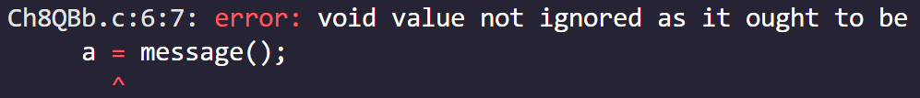
CHAPTER 8 SOLUTIONS
FUNCTIONS
(b)
#include <stdio.h>
void message();
int main()
{
int a;
a = message();
return 0;
}
void message()
{
printf("Viruses are written in C\n");
return;
}
CH 8 Q[B](b)
✍️ message() does not return anything. It’s return type is void.
So, it cannot be assigned to a.
DEAR CODING
BOOK: LET US C
BY YASHAVANT KANETKAR

Slide 13

CHAPTER 8 SOLUTIONS
FUNCTIONS
(b)
#include <stdio.h>
void message();
int main()
{
int a;
message();
return 0;
}
void message()
{
printf("Viruses are written in C\n");
return;
}
CH 8 Q[B](b)
👩‍💻 Output:
DEAR CODING
BOOK: LET US C
BY YASHAVANT KANETKAR

Slide 14
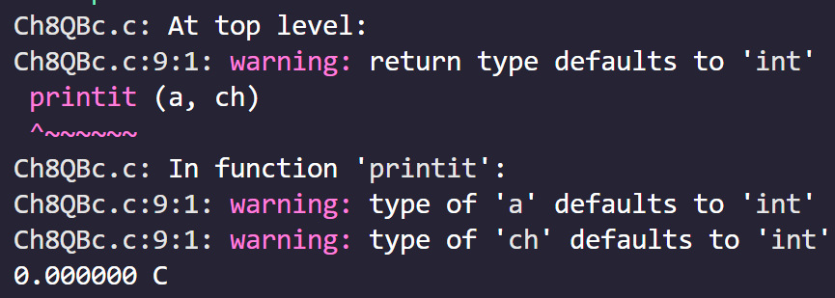
CHAPTER 8 SOLUTIONS
FUNCTIONS
(c)
#include <stdio.h>
int main()
{
float a = 15.5;
char ch = 'C';
printit (a, ch);
return 0;
}
printit (a, ch)
{
printf ("%f %c\n", a, ch);
}
CH 8 Q[B](c)
👈 Output
✍️ printit function parameters doesn’t have a data type. And printit return type is also not mentioned. So, both defaults to int. Program runs but warnings are obtained.
DEAR CODING
BOOK: LET US C
BY YASHAVANT KANETKAR

Slide 15
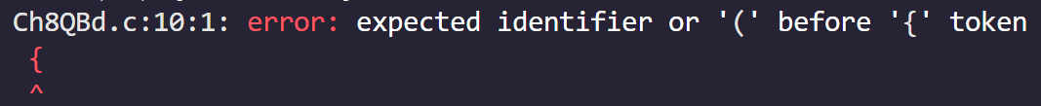
CHAPTER 8 SOLUTIONS
FUNCTIONS
(d)
#include <stdio.h>
void message();
int main()
{
message();
message();
return 0;
}
void message();
{
printf("Praise worthy and C worthy are synonyms\n");
}
✍️ Function definition must have parentheses.
Below two definitions won’t produce any error.
CH 8 Q[B](d)
void message( )
{
}
void message( )
{
;
}
DEAR CODING
BOOK: LET US C
BY YASHAVANT KANETKAR

Slide 16

CHAPTER 8 SOLUTIONS
FUNCTIONS
(d)
#include <stdio.h>
void message();
int main()
{
message();
message();
return 0;
}
void message()
{
printf("Praise worthy and C worthy are synonyms\n");
}
CH 8 Q[B](d)
👩‍💻 Output:
DEAR CODING
BOOK: LET US C
BY YASHAVANT KANETKAR

Slide 17
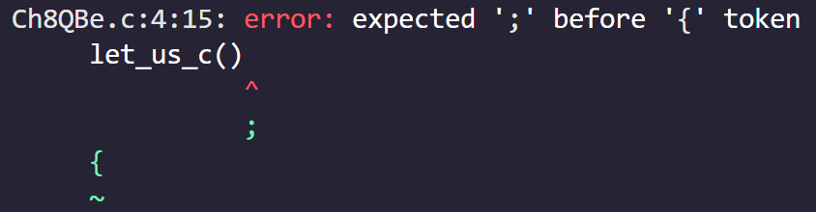
CHAPTER 8 SOLUTIONS
FUNCTIONS
(e)
#include <stdio.h>
int main()
{
let_us_c()
{
printf("C is a Simple minded language \n");
printf("Others are of course no match !\n");
}
return 0;
}
✍️ One function cannot be defined within another function.
CH 8 Q[B](e)
DEAR CODING
BOOK: LET US C
BY YASHAVANT KANETKAR

Slide 18
CHAPTER 8 SOLUTIONS
FUNCTIONS
(e)
#include <stdio.h>
int main()
{
return 0;
}
let_us_c()
printf("C is a Cimple minded language \n");
printf("Others are of course no match !\n");
}
CH 8 Q[B](e)
DEAR CODING
BOOK: LET US C
BY YASHAVANT KANETKAR

Slide 19

CHAPTER 8 SOLUTIONS
FUNCTIONS
(e)
#include <stdio.h>
int main()
{
let_us_c();
return 0;
}
let_us_c()
{
printf("C is a Simple minded language \n");
printf("Others are of course no match !\n");
}
👩‍💻 Output:
CH 8 Q[B](e)
DEAR CODING
BOOK: LET US C
BY YASHAVANT KANETKAR

Slide 20
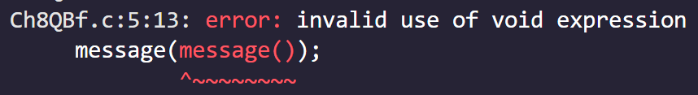
CHAPTER 8 SOLUTIONS
FUNCTIONS
(f)
#include <stdio.h>
void message();
int main()
{
message(message());
return 0;
}
void message()
{
printf("It's a small world after all...\n");
}
CH 8 Q[B](f)
✍️ message() is a function which doesn’t accept any parameter and it doesn’t return any value after completing its execution.
DEAR CODING
✍️ void returned by inner call two message( ) cannot be passed to the outer call.
BOOK: LET US C
BY YASHAVANT KANETKAR

Slide 21

CHAPTER 8 SOLUTIONS
FUNCTIONS
(f)
#include <stdio.h>
void message();
int main()
{
message();
message();
return 0;
}
void message()
{
printf("It's a small world after all...\n");
}
CH 8 Q[B](f)
👩‍💻 Output:
DEAR CODING
BOOK: LET US C
BY YASHAVANT KANETKAR

Slide 22
CHAPTER 8 SOLUTIONS
FUNCTIONS
Q[C] Answer the following:
CH 8 Q[C]
(a) Is this a correctly written function:
int sqr (int a);
{
return (a*a);
}
CH 8 Q[D]
CH 8 Q[C]
CH 8 Q[B]
(b) State whether the following statements are True or False:
DEAR CODING
1. 2. … 9. 10.
BOOK: LET US C
BY YASHAVANT KANETKAR

Slide 23
CHAPTER 8 SOLUTIONS
FUNCTIONS
(a) Is this a correctly written function:
CH 8 Q[C](a)
int sqr (int a);
{
return (a*a);
}
Ans: No, there is an invalid use of ;
Semicolon shouldn’t be present immediately after the sqr( ) in the function definition.
DEAR CODING
BOOK: LET US C
BY YASHAVANT KANETKAR

Slide 24

CHAPTER 6 SOLUTIONS
MORE COMPLEX REPETITIONS
(b) State whether the following statements are True or False:
1. The variables commonly used in C functions are available to all the functions in a program. False
2. To return the control back to the calling function we must use the keyword return. False
3. The same variable names can be used in different functions without any conflict. True
4. Every called function must contain a return statement. False
CH 6 Q[C](b)
DEAR CODING
BOOK: LET US C
BY YASHAVANT KANETKAR

Slide 25
CHAPTER 6 SOLUTIONS
MORE COMPLEX REPETITIONS
(b) State whether the following statements are True or False:
5. A function may contain more than one return statements. True
6. Each return is statement in a function may return a different value. True
7. A function can still be useful even if you don't pass any arguments to it and the function doesn't return any value back. True
CH 6 Q[C](b)
DEAR CODING
9OOK: LET US C
BY YASHAVANT KANETKAR

Slide 26
CHAPTER 6 SOLUTIONS
MORE COMPLEX REPETITIONS
(b) State whether the following statements are True or False:
8. Same names can be used for different functions without any conflict. False
8. A function may be called more than once from any other function. True
10. It is necessary for a function to return some value. False
CH 6 Q[C](b)
DEAR CODING
9OOK: LET US C
BY YASHAVANT KANETKAR

Slide 27
CHAPTER 8 SOLUTIONS
FUNCTIONS
(a) Write a function to calculate the factorial value of any integer entered through the keyboard.
CH 8 Q[D](a)
DEAR CODING
BOOK: LET US C
BY YASHAVANT KANETKAR

Slide 28
CHAPTER 8 SOLUTIONS
FUNCTIONS
(b) Write a function power ( a, b ), to calculate the value of a raised to b.
CH 8 Q[D](b)
DEAR CODING
BOOK: LET US C
BY YASHAVANT KANETKAR

Slide 29
CHAPTER 8 SOLUTIONS
FUNCTIONS
(c) Write a general-purpose function to convert any given year into its Roman equivalent. Use these Roman equivalents for decimal numbers: 1- I, 5-V, 10-X, 50-L, 100-C, 500-D, 1000-M.
Example:
Roman equivalent of 1988 is mdcccclxxxviii. Roman equivalent of 1525 is mdxxv.
CH 8 Q[D](c)
DEAR CODING
BOOK: LET US C
BY YASHAVANT KANETKAR

Slide 30
CHAPTER 8 SOLUTIONS
FUNCTIONS
(d) Any year is entered through the keyboard. Write a function to determine whether the year is a leap year or not.
CH 8 Q[D](c)
DEAR CODING
BOOK: LET US C
BY YASHAVANT KANETKAR

Slide 31
CHAPTER 8 SOLUTIONS
FUNCTIONS
(e) A positive integer is entered through the keyboard. Write a function to obtain the prime factors of this number.
For example, prime factors of 24 are 2, 2, 2 and 3, whereas prime factors of 35 are 5 and 7.
CH 8 Q[D](e)
DEAR CODING
BOOK: LET US C
BY YASHAVANT KANETKAR

Slide 32
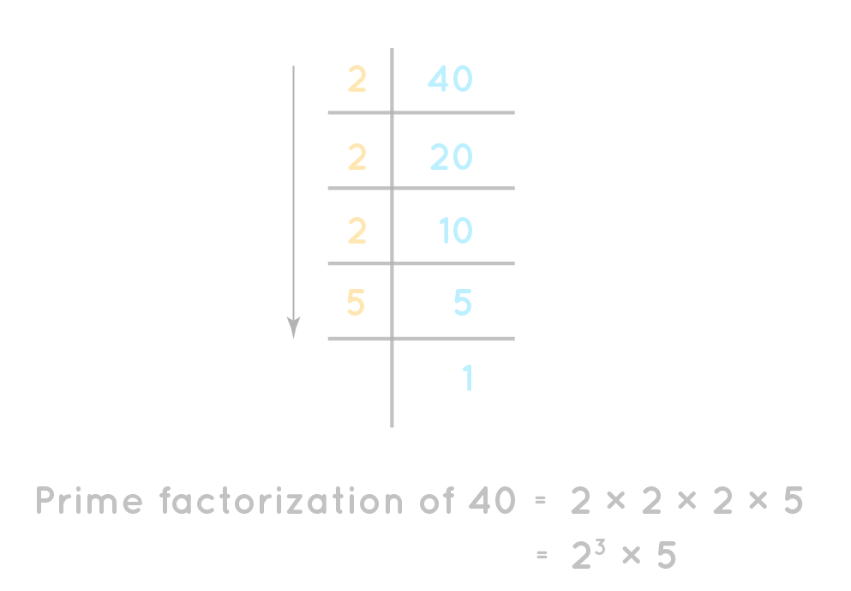
CHAPTER 8 SOLUTIONS
FUNCTIONS
Prime factorization of 40
CH 8 Q[D](e)
DEAR CODING
BOOK: LET US C
BY YASHAVANT KANETKAR

Slide 33
LET US C
BY YASHAVANT KANETKAR
CH 9 Q[B]
CH 9 Q[C]
CH 9 Q[A]
CHAPTER 9 SOLUTIONS
POINTERS

Slide 34


🔴Let me create amazing coding tutorials for you forever!🙂
👇👇👇👇👇👇👇👇👇👇👇👇👇👇👇👇👇👇
👉 SUBSCRIBE 🤛
CH 8 Q[B]
CH 8 Q[B]
CHAPTER 9 SOLUTIONS
POINTERS
CH 8 Q[A]
CH 8 Q[A]
Thanks for your valuable time!

Slide 35
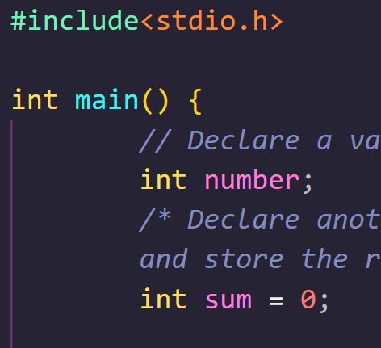
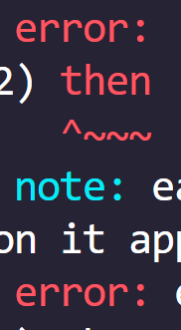

DEAR CODING

